Slide 1
Software Process Models

Slide 2
Overview
Different process models
  Build-and-fix model
  Waterfall model
  Incremental model
  Evolutionary process models
    Rapid prototyping model
    Spiral model
  Agile process models
    Extreme programming
  Object-oriented life-cycle models
    Unified Process
Criteria for deciding on a model

Slide 3
Software Process Models
Process model (Life-cycle model) -steps through which the product progresses
  Requirements phase
  Specification phase
  Design phase
  Implementation phase
  Integration phase
  Maintenance phase
  Retirement

Slide 4
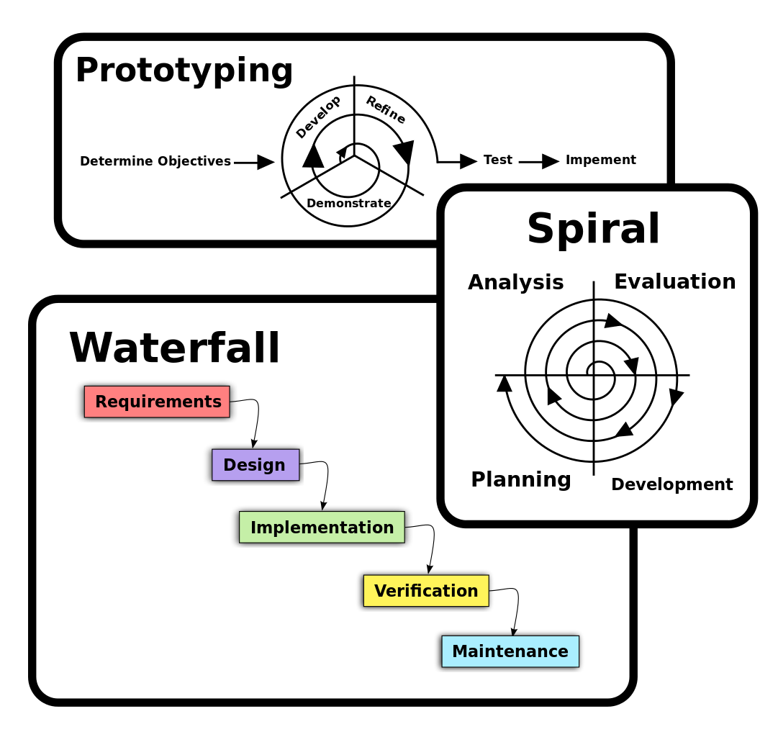
Software Process Models

Slide 5
Build-and-Fix Model
Problems
  No specifications
  No design
Totally unsatisfactory
  High cost
  Difficult maintenance

Slide 6
Waterfall Model
The waterfall model is a sequential design process in which progress is seen as flowing steadily downwards (like a waterfall) through the phases of SDLC.
Waterfall model is an example of a Sequential model. In this model, the software development activity is divided into different phases and each phase consists of a series of tasks and has different objectives. (Refer to Lecture 2)
Waterfall model is the pioneer of the SDLC processes.
Characterized by:
  Feedback loops
  Documentation-driven

Slide 7
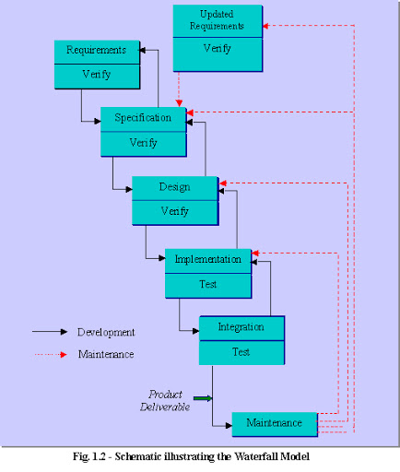

Slide 8
Waterfall Model (contd.)
Advantages
  Enforces disciplined approach
    Documentation for each phase
    Products of each phase checked by SQA group
  Maintenance is easier
    Every change reflected in the relevant documentation
Disadvantages
  Working version of the software will not be available until late in the project time-span
  Specifications are long, detailed, written in a style unfamiliar to the client
  “Blocking states” –some project team members must wait for other team members to complete dependent tasks

Slide 9
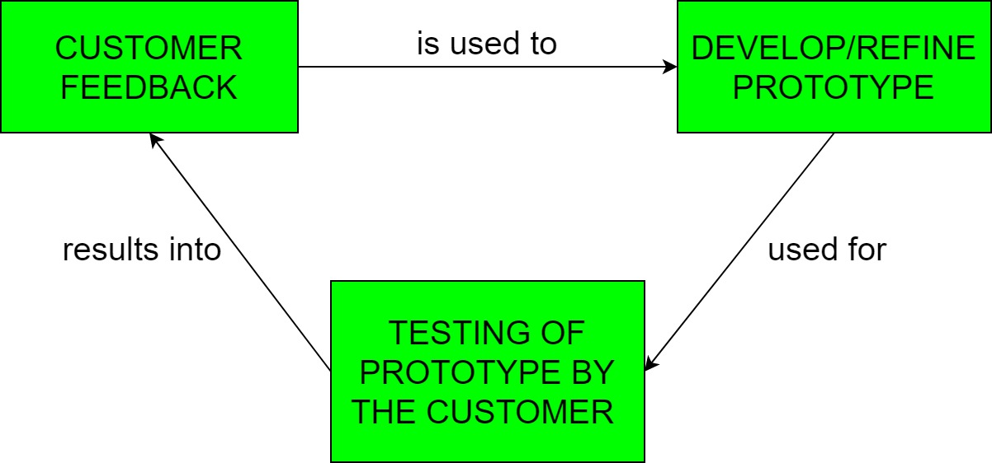
Rapid Prototyping Model
Prototyping is defined as the process of developing a working replication of a product or system that has to be engineered.
It offers a small scale replica of the end product and is used for obtaining customer feedback as described below:

Slide 10
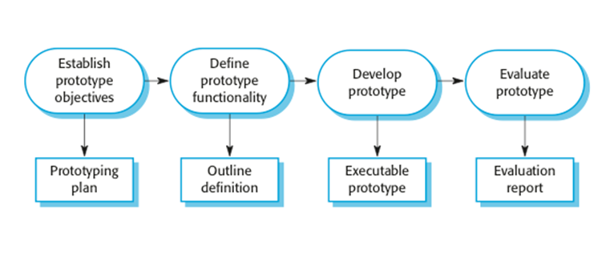
Rapid Prototyping Model (contd.)

Slide 11
Rapid Prototyping Model (contd.)
Rapid prototype characteristics:
  Used in the requirements phase
  Evaluated by the customer/user
  Then, it is discarded -do not turn into product
Rapid prototyping model is not proven and has its own problems
  Possible solution
    Rapid prototyping for defining requirements
    Waterfall model for rest of life cycle

Slide 12
Incremental Model
Incremental Model is a process of software development where requirements are broken down into multiple standalone modules of software development cycle.
Each iteration passes through the requirements, design, coding and testing phases.
Typical product takes from 5 to 25 builds (iterations).

Slide 13
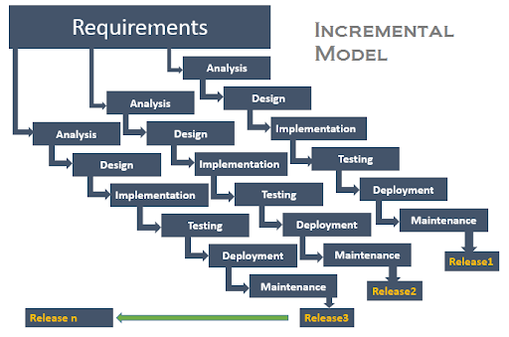
Incremental Model (contd.)

Slide 14
Incremental Model (contd.)
Waterfall and rapid prototyping models
  Deliver complete product at the end
Incremental model
  Deliver portion of the product at each stage
Advantages
  The software will be generated quickly during the software life cycle
  It is flexible and less expensive to change requirements and scope
  Throughout the development stages changes can be done
  This model is less costly compared to others
  A customer can respond to each building
  Errors are easy to be identified

Slide 15
Incremental Model (contd.)
Disadvantages:
  It requires a good planning designing
  Problems might arise due to system architecture as not all requirements collected up front for the entire software lifecycle
  Each iteration phase is rigid and does not overlap each other
  Correcting a problem in one unit requires correction in all the units and consumes a lot of time

Slide 16
When to use Incremental models?
Requirements of the system are clearly understood
When demand for an early release of a product arises
When software engineering team are not very well skilled or trained
When high-risk features and goals are involved
Such methodology is more in use for web application and product based companies

Slide 17
Spiral Model
The spiral model is a risk-driven software development process model.
Based on the unique risk patterns of a given project, the spiral model guides a team to adopt elements of one or more process models, such as incremental, waterfall, or evolutionary prototyping.
Risk Analysis: Identification of potential risk is done while risk mitigation strategy is planned and finalized
Precede each phase by
  Alternatives
  Risk analysis
Follow each phase by
  Evaluation
  Planning of next phase
Notes:
Examples of Software Risks include:
1- Estimation and scheduling
2- Sudden growth in requirements
3- Employee turnover
4- Productivity issues
5- Compromising on designs
6- Technical risks

Slide 18
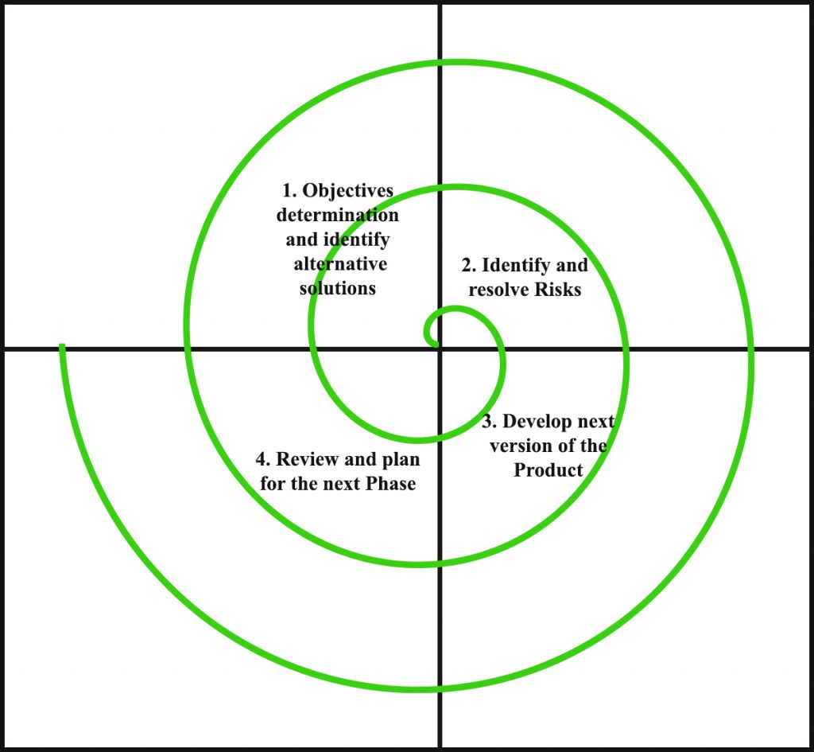
Simplified Spiral Model

Slide 19
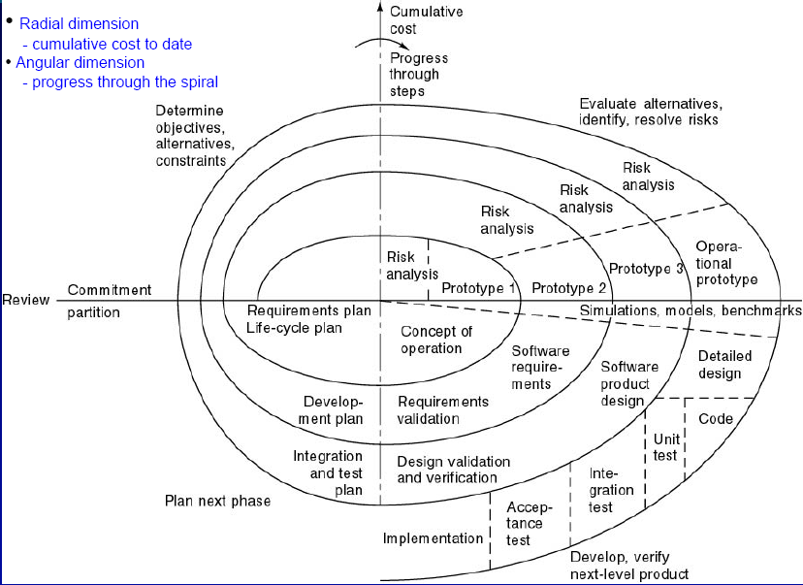
Full Spiral Model

Slide 20
When to use Spiral Methodology?
When project is large
When releases are required to be frequent
When creation of a prototype is applicable
When risk and costs evaluation is important
For medium to high-risk projects
When requirements are unclear and complex
When changes may require at any time
When long term project commitment is not feasible due to changes in economic priorities

Slide 21
Advantages of Spiral Model
Additional functionality or changes can be done at a later stage
Cost estimation becomes easy as the prototype building is done in small fragments
Continuous or repeated development helps in risk management
Development is fast and features are added in a systematic way
There is always a space for customer feedback

Slide 22
Disadvantages of Spiral Model
Risk of not meeting the schedule or budget
It works best for large projects only also demands risk assessment expertise
For its smooth operation spiral model protocol needs to be followed strictly
Documentation is more as it has intermediate phases
It is not advisable for smaller project, it might cost them a lot

Slide 23
Agile Process Models
Agile software engineering combines a philosophy and a set of development guidelines
Philosophy
  Encourages customer satisfaction and early incremental delivery of the software
  Small highly motivated project teams
  Informal methods
  Minimal software engineering work products
  Overall development simplicity
Development guidelines
  Stress delivery over analysis and design
  Active and continuous communication between developers and customers

Slide 24
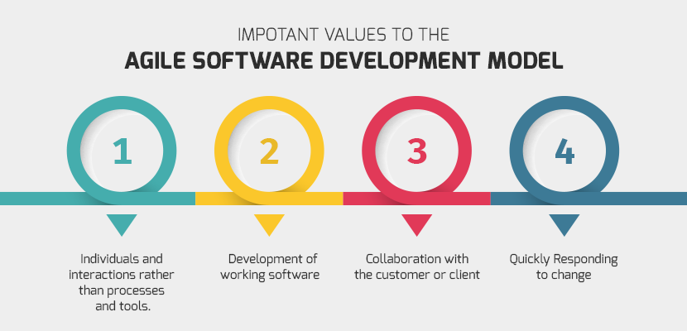
Agile Process Models (contd.)

Slide 25
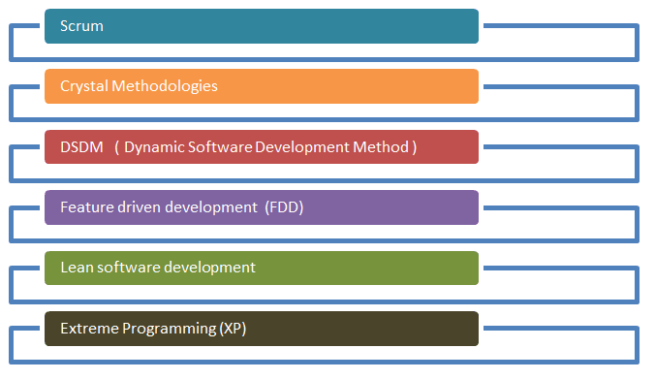
Agile Process Models (contd.)
Notes:
Presentation Required!

Slide 26
Agile vs. Waterfall Method
Agile Model | Waterfall Model
Agile method proposes incremental and iterative approach to software design | Development of the software flows sequentially from start point to end point.
The agile process is broken into individual models that designers work on | The design process is not broken into an individual models
The customer has early and frequent opportunities to look at the product and make decision and changes to the project | The customer can only see the product at the end of the project
Agile model is considered unstructured compared to the waterfall model | Waterfall model are more secure because they are so plan oriented

Slide 27
Agile vs. Waterfall Method (contd.)
Agile Model | Waterfall Model
Small projects can be implemented very quickly. For large projects, it is difficult to estimate the development time. | All sorts of project can be estimated and completed.
Error can be fixed in the middle of the project. | Only at the end, the whole product is tested. If the requirement error is found or any changes have to be made, the project has to start from the beginning
Development process is iterative, and the project is executed in short (2-4) weeks iterations. Planning is very less. | The development process is phased, and the phase is much bigger than iteration. Every phase ends with the detailed description of the next phase.
Documentation attends less priority than software development | Documentation is a top priority and can even use for training staff and upgrade the software with another team

Slide 28
Agile vs. Waterfall Method (contd.)
Agile Model | Waterfall Model
In agile testing when an iteration end, shippable features of the product is delivered to the customer. New features are usable right after shipment. It is useful when you have good contact with customers. | All features developed are delivered at once after the long implementation phase.
Testers and developers work together | Testers work separately from developers
At the end of every sprint, user acceptance is performed | User acceptance is performed at the end of the project.
It requires close communication with developers and together analyze requirements and planning | Developer does not involve in requirement and planning process. Usually, time delays between tests and coding

Slide 29
Extreme Programming (XP)
Somewhat controversial new approach; variation of the incremental model
First step
  Determine features that client wants (stories)
  Estimate duration and cost of each feature
Client selects stories for each successive build
Each build is divided into tasks
Test cases for a task are drawn up
Pair programming –working with a partner on one screen
Continuous integration of tasks

Slide 30
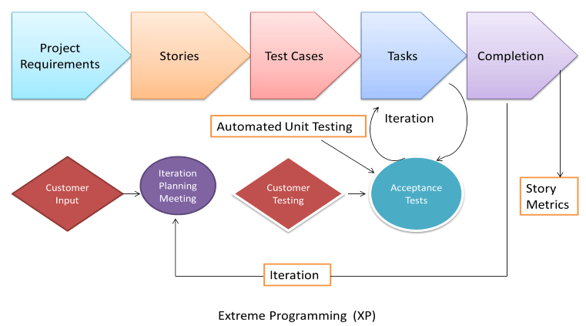
Extreme Programming (contd.)

Slide 31
Features of XP
Computers are put in center of large room lined with cubicles
Client representative works with the XP team at all the times
Individual cannot work overtime for 2 successive weeks
There is no specialization
  all members of the XP team work on specification, design, code, and testing
There is no overall design phase before various builds are constructed – Refactoring

Slide 32
Advantages of Agile Model
Customer satisfaction by rapid, continuous delivery of useful software.
People and interactions are emphasized rather than process and tools. Customers, developers and testers constantly interact with each other.
Working software is delivered frequently (weeks rather than months).
Face-to-face conversation is the best form of communication.
Close, daily cooperation between business people and developers.
Regular adaptation to changing circumstances.
Even late changes in requirements are welcomed

Slide 33
Disadvantages of Agile model
In case of some software deliverables, especially the large ones, it is difficult to assess the effort required at the beginning of the software development life cycle.
There is lack of emphasis on necessary designing and documentation.
The project can easily get taken off track if the customer representative is not clear what final outcome that they want.
Only senior programmers are capable of taking the kind of decisions required during the development process. Hence it has no place for newbie programmers, unless combined with experienced resources.

Slide 34
When to use Agile model
When new changes need to be implemented. The freedom agile gives to change is very important. New changes can be implemented at very little cost because of the frequency of new increments that are produced.
To implement a new feature the developers, need to lose only the work of a few days, or even only hours, to roll back and implement it.
Both system developers and stakeholders alike, find they also get more freedom of time and options than if the software was developed in a more rigid sequential way.
Having options gives them the ability to leave important decisions until more or better data or even entire hosting programs are available; meaning the project can continue to move forward without fear of reaching a sudden standstill.

Slide 35
Unified Process
Unified process is a framework for OO software engineering using UML (Unified Modeling Language)
Unified process (UP) is an attempt to draw on the best features and characteristics of conventional software process models, but characterize them in a way that implements many of the best principles of agile software development.

Slide 36
Unified Process Characteristics
It is an iterative and incremental development framework
It is architecture-centric with major work being done to define and validate an architectural design for most coding is done
It is risk-focused and emphasizes that highest-risk factors be addressed in the earliest deliverables possible
It is use-case and UML model driven with nearly all requirements being documented in one of those forms

Slide 37
Unified Process: Phases
Inception phase
  Encompasses the customer communication and planning activities
  Rough architecture, plan, preliminary use-cases
Elaboration phase
  Encompasses the customer communication and modeling activities
  Refines and expands preliminary use-cases
  Expands architectural representation to include: use-case model, analysis model, design model, implementation model, and deployment model
  The plan is carefully reviewed and modified if needed

Slide 38
Unified Process: Phases
Construction phase
  Analysis and design models are completed to reflect the final version of the software increment
  Using the architectural model as an input develop or acquire the software components, unit tests are designed and executed, integration activities are conducted
  Use-cases are used to derive acceptance tests
Transition phase
  Software is given to end-users for beta testing
  User report both defects and necessary changes
  Support information is created (e.g., user manuals, installation procedures)
  Software increment becomes usable software release

Slide 39
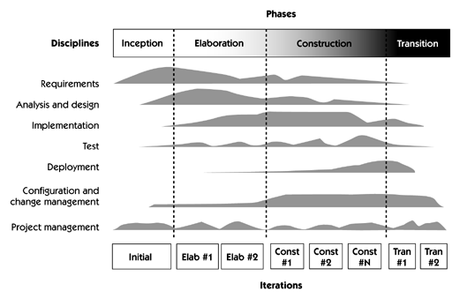
Unified Process Phases

Slide 40
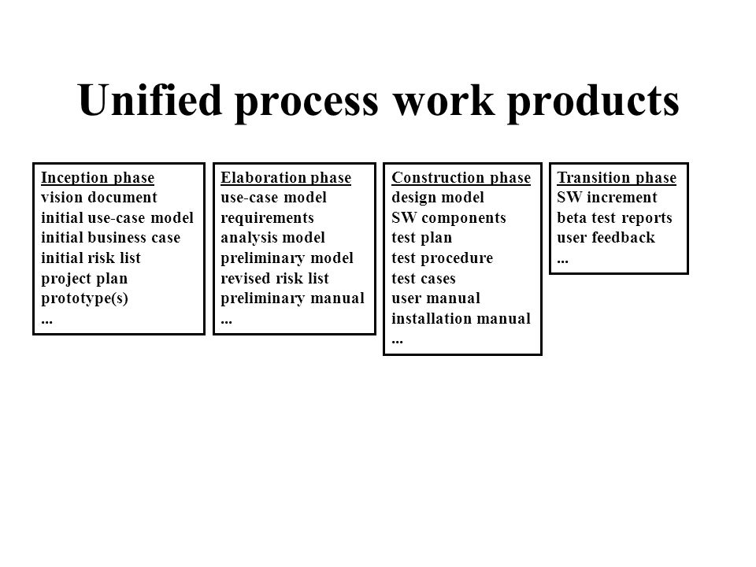

Slide 41
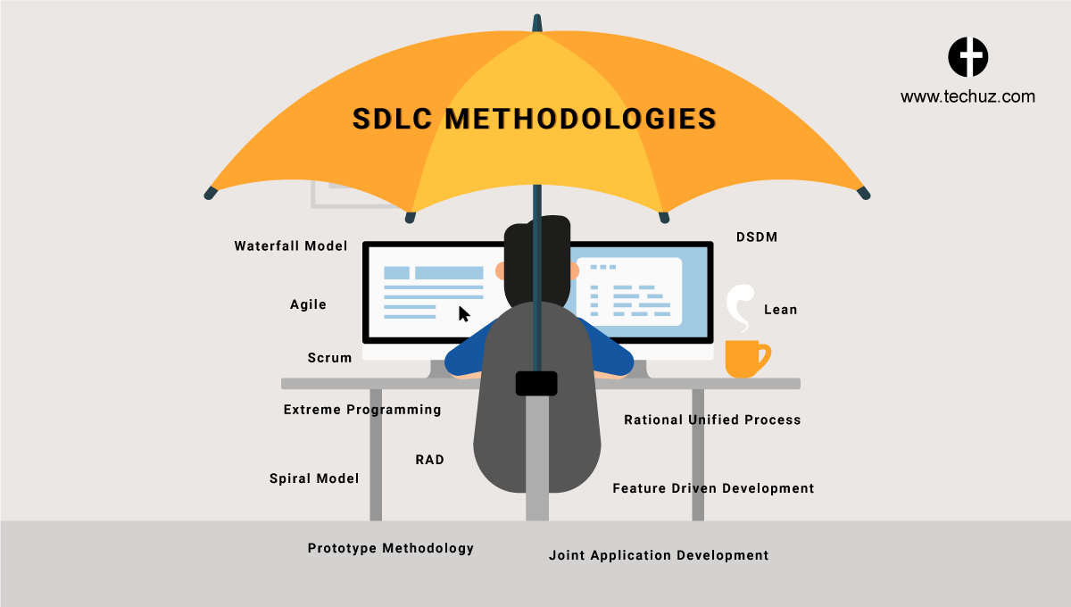
How to Choose between SDLC Methods?

Slide 42
How to Choose between SDLC Methods?
To know which is the best model out of all the different types of SDLC models, it is important to understand that each of these approaches are suitable for different projects, environments, and requirements.
For example, if your project is simple and straightforward with set requirements that do not need to be changed, then Waterfall is best suited for it.
However, if your project is large-scale and consists of multiple components and segments, then choosing Iterative or Spiral methodology would suit your project better.

Slide 43
How to Choose between SDLC Methods?
To answer the question simply, there is no ONE model is best from all the SDLC models discussed.
A preference of one method over the others cannot be determined.
However, to select the right SDLC methodologies, you should know all the types of SDLC models, assess the requirements of all the stakeholders and then decide on a method that best fits your needs.

Slide 44
Criteria for deciding on a model include
Criteria for deciding on a model include
  Product Complexity
  Product Size
  Magnitude of Changes
  Frequency of Changes
  Skills of the Dev Team
  Time constraints
  Access to Users

Slide 45
Questions??

